Slide 1
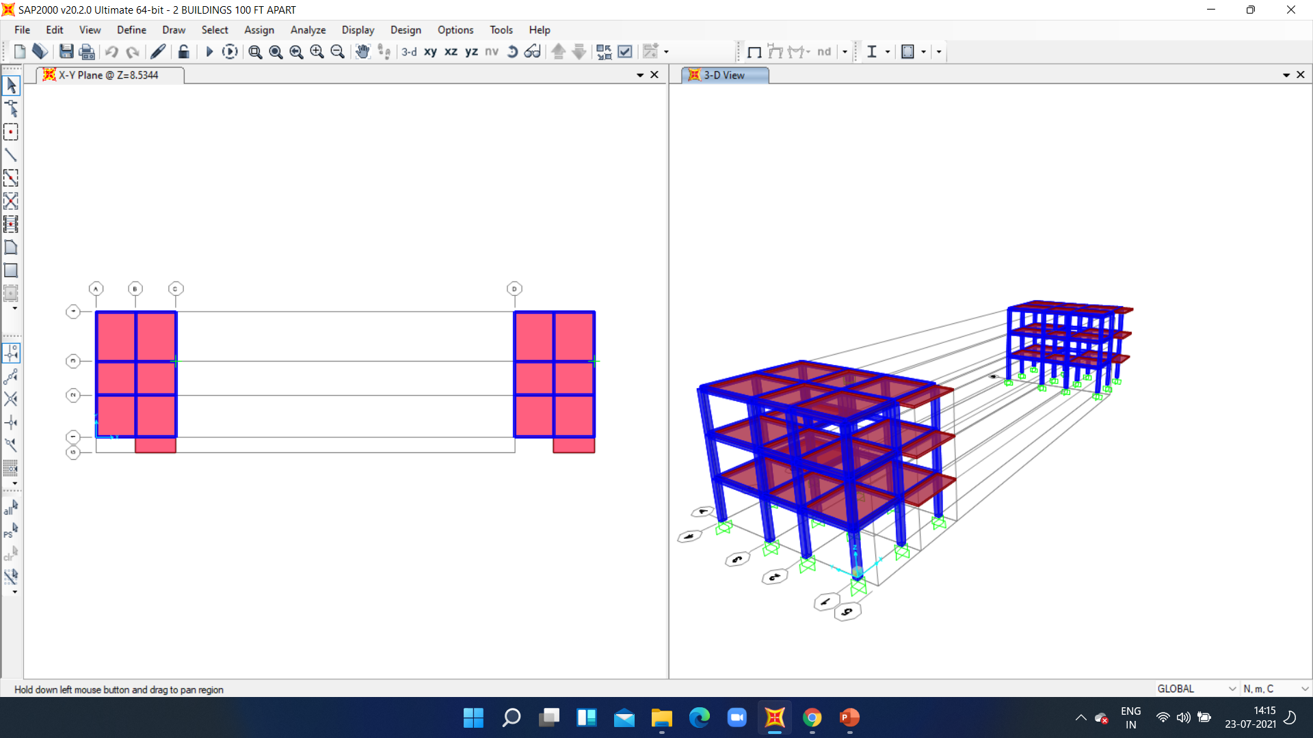
STRUCTURE SUPER COMBO
DESCON SOCIETY
FINAL PROBLEM
PART : 2

Slide 2
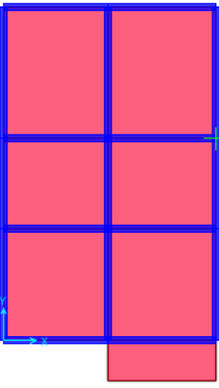
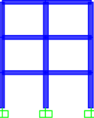
DIMENSIONS OF BUILDING
HAVE MADE SYMMETRIC BUILDINGS
11’7”
11’11”
12’5”
9’4”
9’4”
10’
14’7”
9’4”
4’6”

Slide 3
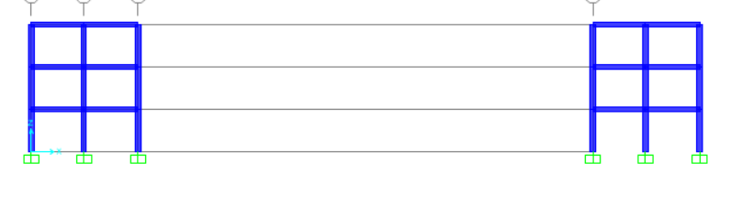
100 ft.

Slide 4
DIFFERENT MATERIALS USED :
REBAR HYSD Grade500
M20 concrete
Total structures used:
Beam=51
Column=36
Rectangular slab 130=21

Slide 5
Different types of applied loads
DEAD LOAD
LIVE LOAD
ROOF LIVE
WALL
PARAPET WALL
PARTITION
EARTQUAKE X DIR.
EARTHQUAKE Y DIR.

Slide 6
Procedure:
Define grid
Define materials to be used and structures
Draw model and fix the joint restraints
Mess the area part .
Define Diaphragm.
Apply loads and sesmic loads
Analyse the model by checking if all the members pass the tests of frame

Slide 7
THANK YOU
By: PRIYA SINGH
Roll No.:200728

